Slide 1
MINI PROJECT AND SEMINAR (CS271)

Slide 2
User Activity Analysis to Detect Borderline Bots in Twitter
Under the guidance of
Dr. V.AKILA
Assistant Professor
Department of Computer Science and Engineering
Submitted by
Hari Prasath.R
Praveen.M

Slide 3
Introduction
The Bot is a software application that runs automated tasks over the Internet. Typically, bots perform tasks that are simple and repetitive much faster than a person could.
Bots are created for many different reasons such as conducting a distributed denial of service(DDOS), spreading spam, conducting click-fraud scams, stealing personal user information(e.g. credit card numbers, social security numbers), or taking advantage of the powerful computational resources offered by the bots to carry some distributed computing tasks.
Bots interact over legitimate communication channels.
Twitter bots are automated Twitter accounts controlled by bot software.
While their purpose is to tweet, retweet, liking tweets and following other users for a specific goals on a large scale. The Botnets are large networks of bots.

Slide 4
Problem Definition
Bots evolve over a period of time.
Existing Techniques detects Bots of same pattern/ similar kinds of bots, Thus Borderline bots are not detected.
Most of the Existing Techniques use user, tweet or graphical features whereas, the use of user behaviours are still open field to explore.
Uncovering borderline bots that follow unique patterns using Information gain(Entropy) approaches will yield better performance.

Slide 5
Objectives
To detect the Borderline bots in Twitter through user Behavior Analysis.
To identify what features contribute in detection of borderline bots.
To design an efficient bot detection model - to detect borderline bot based on Information Gain( Entropy ).

Slide 6
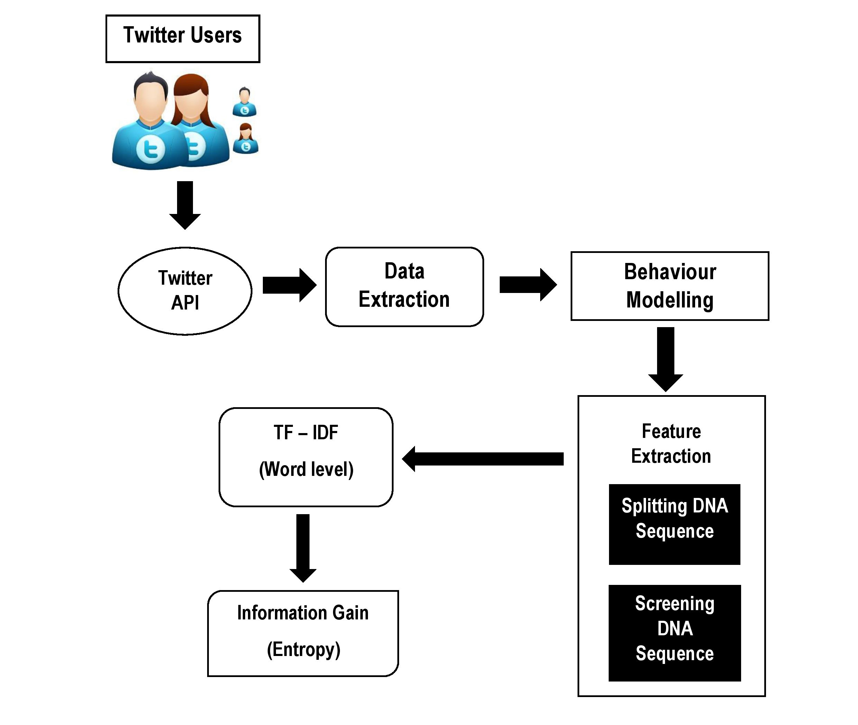
Work Description
MODEL DIAGRAM

Slide 7
Feature Extraction(DNA sequence)
Digital DNA sequences on Twitter could include a different base for each user-to-user interaction type: comments (C), likes (L), Retweet (R), Tweet (T) and so on. Then, interactions can be encoded as strings formed by such characters according to the sequence of user-performed actions.
Just like its biological predecessor, digital DNA is a compact representation of information—for example, a Twitter user’s timeline could be encoded as a single string of 3,200 characters (one character per tweet)
Firstly, all tweets are sorted in chronological order. Secondly, the behavior of an account replacing each tweet, retweet & reply of this account is modelled by the characters L, S, T & C respectively, thus creating a DNA sequence.

Slide 8
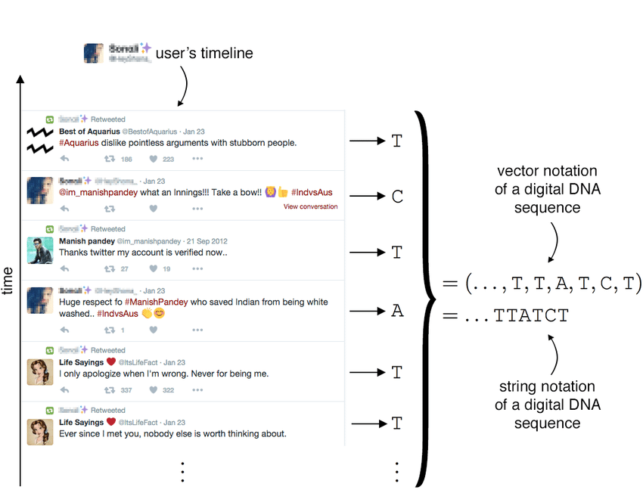
In digital DNA each user action is associated to a given character, according to a predefined alphabet.

Slide 9
The bases used to create a digital DNA sequence are represented as a finite set of unique symbols or characters, denoted by B and defined as:
B = {B1, B2, . . . , BN } Bi 6= Bj ∀ i, j = 1, . . . , N ∧ i 6= j
The set B is also called the alphabet of a digital DNA sequence. A digital DNA sequence is an ordered tuple, or row vector, of characters (i.e., a string) whose possible values are defined by the bases of its alphabet. A sequence s is defined as:
s = (b1, b2, . . . , bn) bi ∈ B ∀ i = 1, . . . , n
The number of actions encoded in a DNA sequence determines the length of the sequence, n = |s|. Thus, a limited number of bases in an alphabet can be used to create sequences of arbitrary length

Slide 10
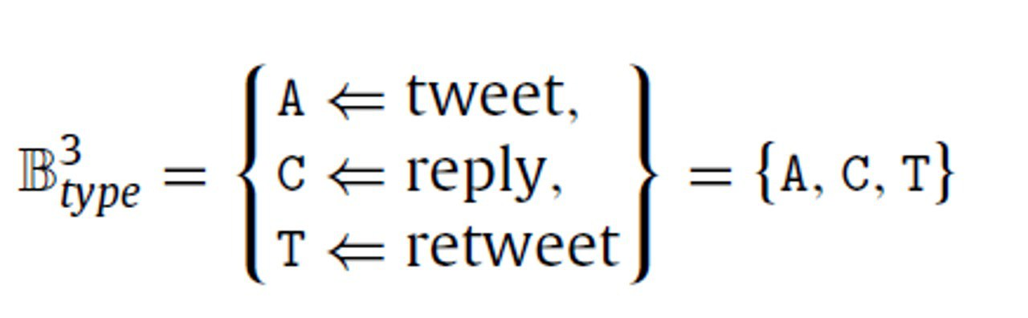
The process of extracting the digital DNA sequence of a Twitter user, by scanning its timeline according to an alphabet defined as follows:
The B 3 type alphabet encodes user behaviors according to their type of tweets produced, either tweets, retweets , or replies

Slide 11
On Twitter could include a different base for each user-to-user interaction type.
A-------→ Tweet
T--------→ Retweet
C-------→ Reply
D-------→ Link/URL
Interactions can be encoded as strings formed by such characters according to the sequence of user-performed actions.

Slide 12
The DNA Sequencing technique only exploits Twitter timeline data to perform Bot detection.
Envision of possibility to exploit results of our DNA-inspired technique as a feature in a more complex detection system.
DNA -------→Tweet Type
DNA-------→ Tweet Content
Results of these models could be used simultaneously in an ensemble or voting system.

Slide 13
TF-IDF
We generally compute a score for each word to signify its importance in the document and corpus.
This method is a widely used technique in Information Retrieval and Text Mining.
A popular approach used to weigh terms for NLP tasks because it assigns a value to a term according to its importance in a document scaled by its importance across all documents in your corpus .
𝑡𝑓𝑖𝑑𝑓(𝑡,𝑑,𝐷)=𝑡𝑓(𝑡,𝑑).𝑖𝑑𝑓(𝑡,𝐷)
Which mathematically eliminates naturally occurring words in the English language, and selects words that are more.

Slide 14
Information Gain
Information gain is the reduction in entropy or surprise by transforming a dataset and is often used in training decision trees.
Information gain is calculated by comparing the entropy of the dataset before and after a transformation.
Low Probability-----------→ More Information.
High Probability --------- → Less Information.
Whereas a distribution where events have equal probability has a larger entropy.
Information gain (T,x)=Entropy(T)-Average Entropy(T,x)
Entropy is the measures of impurity, disorder or uncertainty in a bunch of examples.

Slide 15
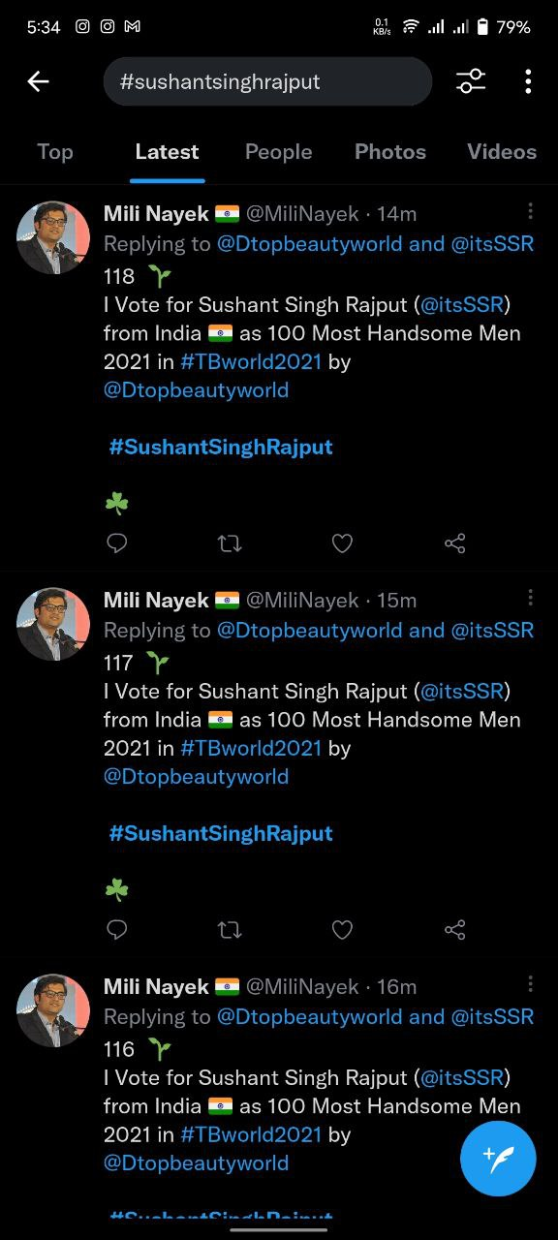
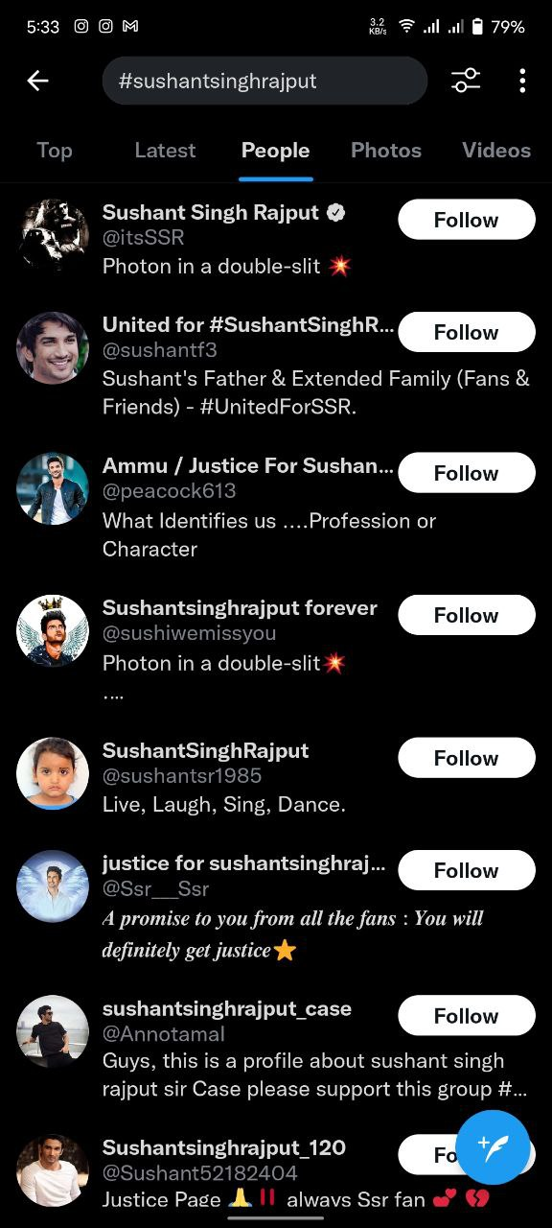
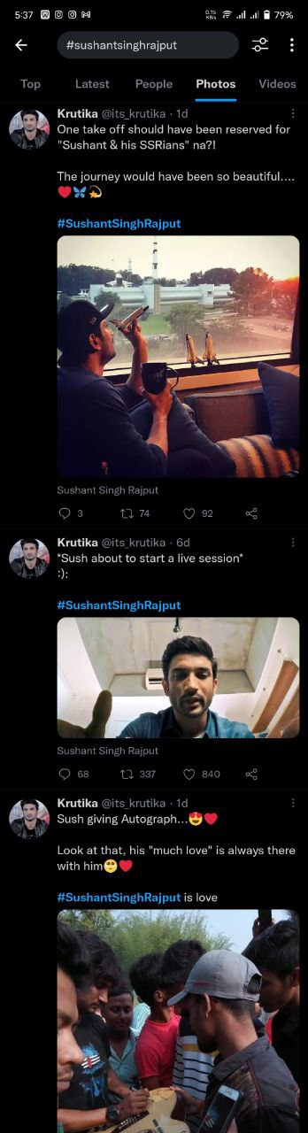
Sample Image in Twitter

Slide 16
Conclusion
In this work, we have considered only the user behaviors to detect Twitter Bots.
The Research experiments includes a real time Twitter dataset collected through Twitter API.
We model the user behaviors as DNA sequence and design Information gain(Entropy) based approach to detect Bots from Humans.
The Essence of our proposed work determines the Information Gain in the DNA sequence which acts as the indicator for Automation.

Slide 17
Reference
[1] S Cresci, R Di Pietro, M Petrocchi, A Spognardi, M Tesconi, “Emergent properties, models, and laws of behavioral similarities within groups of twitter users”, 2020.
[2] Aljohani NR, Fayoumi A, Hassan SU, “Bot prediction on social networks of Twitter in altmetrics using deep graph convolutional networks”, 2020.
[3] Jonathan Debure, Stephan Brunessaux, Camelia Constantin, Cédric du Mouza, “A pattern-based approach for an early detection of popular Twitter accounts”, 24th Symposium on International Database Engineering & Applications, 2020.
[4] Stefano Cresci , Marinella Petrocchi, Angelo Spognardi ,Stefano Tognazzi. “Online Social Networks and Media_ On the capability of evolved spambots to evade detection via genetic engineering”, 2019.
[5] Dijana Kosmajac, Vlado Keselj, “Twitter User Profiling: Bot and Gender Identification”, International Conference of the Cross-Language Evaluation Forum for European Languages, 2019.

Slide 18
[6] Feng Wei, Uyen Trang Nguyen, “Twitter Bot Detection Using Bidirectional Long Short-Term Memory Neural Networks and Word Embedding's”, IEEE International Conference on Trust, Privacy and Security, 2019.
[7] D Kosmajac, V Keselj, “Twitter bot detection using diversity measures”,
International Conference of the Cross-Language, 2019.
[8] M Petrocchi, S Cresci, R Di Pietro, A Spognardi, M Tesconi, “ Exploiting digital DNA for the analysis of similarities in Twitter behaviors”, 2017.
[9] A Spognardi, Stefano Cresci, R Di Pietro, M Petrocchi, and M Tesconi. “DNA-inspired online behavioral modeling and its application to Spambot detection” IEEE INTELLIGENT SYSTEMS, arXiv:1602.00110v1 Jan 2016.
[10] X. Hu, J. Tang, and H. Liu, “Online social spammer detection,” in AAAI Conference on Artificial Intelligence, 2014, pp. 59–65.

Slide 19
THANK YOU

